Slide 1


Finding the Cheat Codes for Game Development
Jessica Conroy
JConroy1@Umbc.edu
Data 606 Capstone in Data Science

Slide 2
Project Overview
Goal: This project aims to investigate the features of successful video games as well as how those features have changed, or not changed, as a result of the COVID-19 pandemic.
Motivation: Gaming is a massive industry that continues to grow and develop. Identifying key features of successful games is one way to gain an edge in an extremely competitive market.
Project Plan:
Apply natural language processing techniques to summarize the descriptive game text and identify clusters of similar games.
Use clusters to investigate characteristics of games with high ownership and high review scores.

Slide 3
Project Structure
Data Acquisition
Collect Data Via API
Initial Data Cleaning
Initial EDA
Explore Data Features
Second Round of Data Cleaning and Processing
Secondary EDA
Text Analysis (Keyword Extraction, Topic Modeling)
Feature Selection and Modeling
Text Clustering (Kmeans)
Cluster Analysis
Topic Modeling and descriptive statistics

Slide 4
Research Questions
What game characteristics are predictive of a high game rating?
Have these characteristics changed as a result of the covid pandemic?
Hypothesis: Multiplayer games increased in popularity

Slide 5

Data
Unit of Analysis: Individual games released on the Steam platform
Data Sources:
Steam Web API
list of all game IDs and names
Core game metadata
Top game reviews
Steamspy API
Supplementary metadata
APPID was used as the unique identifier to join all data into a single dataset
After Processing:
14,952 Rows
79 variables
2.1% missing data

Slide 6
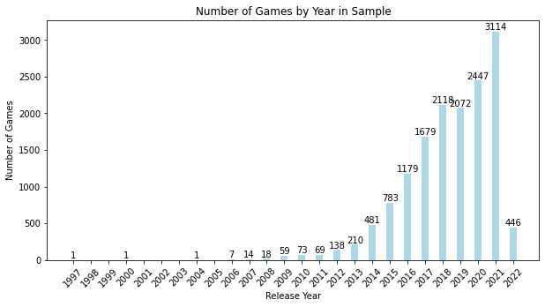
Exploratory Analysis – Key Data Features
Release Year
The Pre and During COVID-19 analyses will require analyzing data from 2018 2019 and comparing to 2021 and 2022.
Pre-COVID-19: 4,190
During-COVID-19: 3,560
This exploratory analysis will inform whether or not pre-COVID data is used in the ML model development stage of this project.
One limitation of this analysis is that games that have been out longer are more likely to have a larger corpus of review text. This is one potential confound for our text analysis to keep in mind later.

Slide 7
Topic Modeling and Similarity Analysis
Used BERT Sentence encoding to vectorize the text for Descriptions, Reviews, and Tags.
Used Latent Dirichlet Allocation (LDA) and Non-negative Matrix Factorization (NMF) for topic modeling
Used cosine similarity to find the degree of similarity across years and the covid corpora.
Notes:
LDA is a generative probabilistic model that groups words into topics using Dirichlet distributions. NMF topic modeling, on the other hand, is a statistical model for reducing dimensionality of the input text into specific topics.

Slide 8
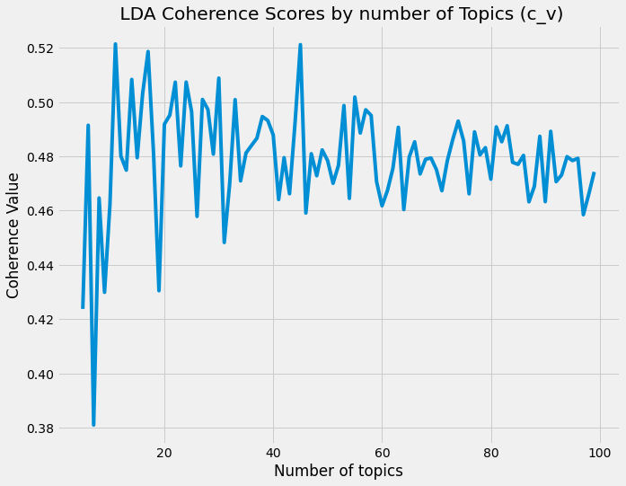
Topic Modeling – LDA Coherence Scores
Ideal number of topics for the entire game descriptions corpus: 11
Used c_v metric for calculating coherence
Notes:
Using c_v over other metrics like u_mass to calculate coherence because c_v produced better results in testing
Röder, M., Both, A., & Hinneburg, A. (2015). Exploring the Space of Topic Coherence Measures. Proceedings of the Eighth ACM International Conference on Web Search and Data Mining, 399–408. https://doi.org/10.1145/2684822.2685324
Zvornicanin, E. (2021). When Coherence Score is Good or Bad in Topic Modeling? | Baeldung on Computer Science. https://www.baeldung.com/cs/topic-modeling-coherence-score
(https://github.com/dice-group/Palmetto/issues/12)

Slide 9
Topic Modeling – Top 5 LDA Topics for descriptions
Topic # | Full Corpus | Pre COVID | During COVID
1 | object, mansion, prison, collector, room, spell, kei, ghost, puzzl, click, hidden, killer, warden, detect | nanobot, plai, tone, includ, song, new, electr, dinosaur, authent, guitar, bass, estim, rock, queen, girlfriend | world, team, charact, new, militari, object, featur, wai, time, forc, manag, plai, battl, locat
2 | track, music, pack, race, us, car, theme, includ, maker, featur, song, soundtrack, new, rpg | aerial, demon, adjac, board, ransack, squar, us, gestur, piec, press, fruit, wallpap, player, button | us, pack, maker, rpg, content, seri, commerci, edit, type, tile, treasur, quotrpg, includ, adultr, gore
3 | pack, skin, dlc, includ, content, item, unlock, purchas, model, us, new, charact, set, anim, outfit | orion, fish, spider, attack, synth, brink, black, loop, breez, crank, minnow, equip, shad, releasehttpsstoresteampoweredcomappabout, escap | spider, weapon, new, us, life, simul, space, player, paint, tool, salt, build, time, ship
4 | world, level, new, us, differ, explor, uniqu, build, time, wai, surviv, challeng, power, plai | recur, drag, side, postprocess, basin, lucid, brief, new, red, weight, useless, hold, origin, oper, speed | us, music, metal, theme, battl, town, track, pack, project, drama, poker, neon, includ, sound
5 | enemi, weapon, new, ship, space, shoot, plai, includ, player, control, level, mode, gun, mission | dead, fighter, aliv, core, breaker, offer, content, free, period, time, download, limit, note, us | dlc, train, includ, file, battl, base, classic, contain, rout, tank, map, simul, steam, enemi
Ideal number of topics for the entire game descriptions corpus: 11
Pre-COVID: 55
During COVID: 68
Notes:
We are using u_mass over c_v to calculate coherence because u_mass measures relationships with preceding and subsequent words and tends to perform better when compared with other coherence metrics (https://github.com/dice-group/Palmetto/issues/12)

Slide 10
Topic Modeling – Top 5 NMF Topics for Descriptions
Topic # | Full Corpus | Pre COVID | During COVID
1 | fight, time, enemi, weapon, differ, level, plai, mode, player, game | fight, skill, time, control, enemi, differ, mode, player, plai, game | shoot, baseor, break, line, gamein, aboutquottig, tanksthrough, topdown, tank, enemi
2 | line, break, shoot, baseor, gamein, aboutquottig, tank, tanksthrough, topdown, enemi | price, note, discount, late, costum, instal, twice, care, purchas, content | experi, friend, stori, mode, differ, world, time, player, plai, game
3 | amp, plai, new, includ, authent, electr, song, tone, bass, guitar | youquot, new, plai, includ, song, electr, authent, bass, guitar, tone | win, game, combat, aboutthi, larg, number, fighter, player, enemi, shoot
4 | updat, discount, late, twice, note, instal, care, costum, purchas, content | relax, complet, level, difficulti, contain, piec, game, jigsaw, solv, puzzl | dlc, defeat, classic, base, contain, guard, reopen, indring, feature, tank
5 | logic, relax, piec, jigsaw, challeng, difficulti, game, solv, level, puzzl | island, life, secret, new, charact, explor, mysteri, stori, world, adventur | necessari, updat, set, purchas, sell, separ, product, version, content, item
Notes:
We are using u_mass over c_v to calculate coherence because u_mass measures relationships with preceding and subsequent words and tends to perform better when compared with other coherence metrics (https://github.com/dice-group/Palmetto/issues/12)

Slide 11
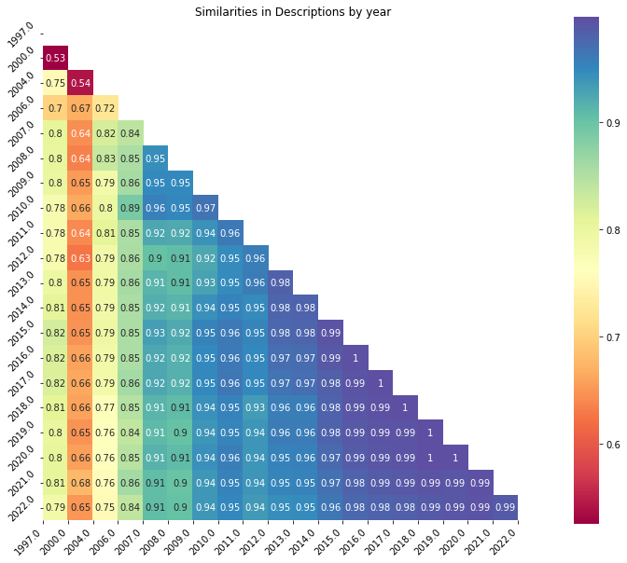
Similarity Analysis Cosine Similarity was used to calculate the differences between document vectors - Length of corpus is likely a confounding factor for this similarity. Cosine Similarity between pre-COVID and during COVID corpora: Description: 0.9938202 Reviews: 0.931086 Tags: 0.884515
Notes:
We are using u_mass over c_v to calculate coherence because u_mass measures relationships with preceding and subsequent words and tends to perform better when compared with other coherence metrics (https://github.com/dice-group/Palmetto/issues/12)

Slide 12
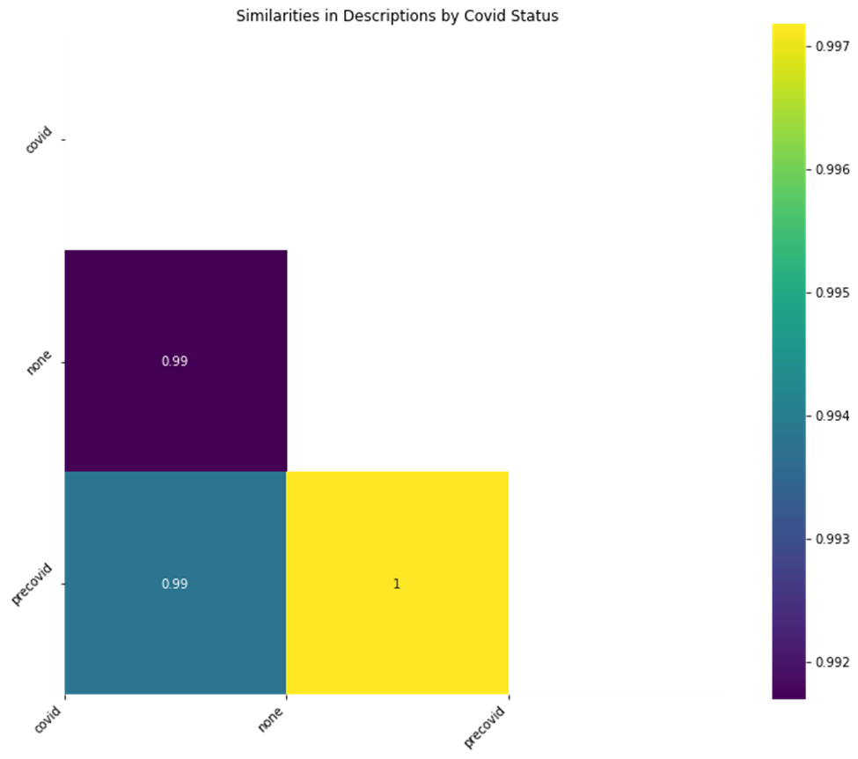
Similarity Analysis Conclusions: Games released before COVID and during COVID are sufficiently similar for clustering analysis.
Notes:
We are using u_mass over c_v to calculate coherence because u_mass measures relationships with preceding and subsequent words and tends to perform better when compared with other coherence metrics (https://github.com/dice-group/Palmetto/issues/12)

Slide 13
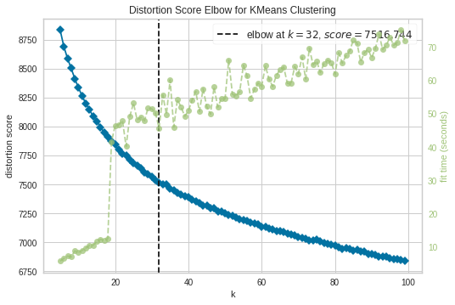
Clustering Analysis
Methods:
Vectorized description text using BERT Sentence encoder
Identified number of clusters using the Elbow Method
To perform the clustering using Kmeans
Number of Clusters: 32
The elbow method runs the kmeans clustering on a range of K values and takes the average score for all clusters. The distortion is the sum of squared distances from each point to it’s assigned center.

Slide 14
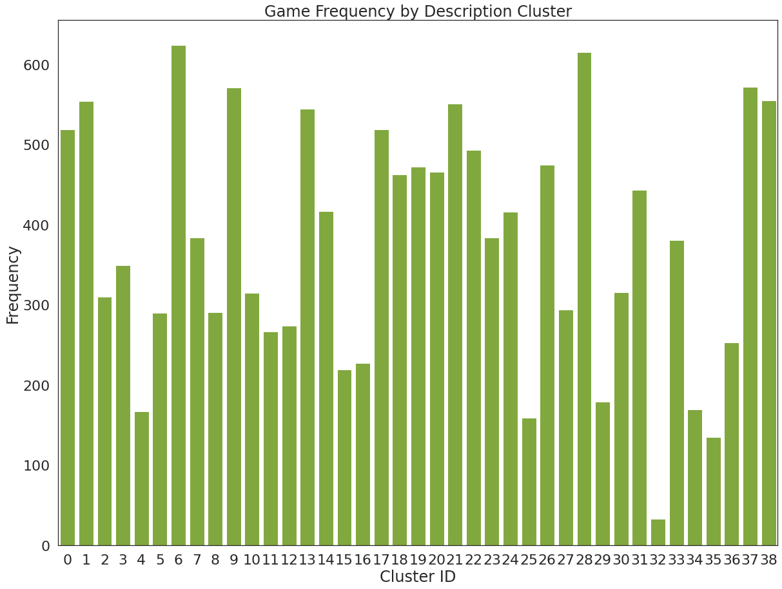
Cluster Investigation
32 Clusters
Topic Modeling using LDA
Descriptive statistics
Target Metrics
Owner counts
Review Score
Review Ratios (number of Positive reviews/ Negative reviews)

Slide 15
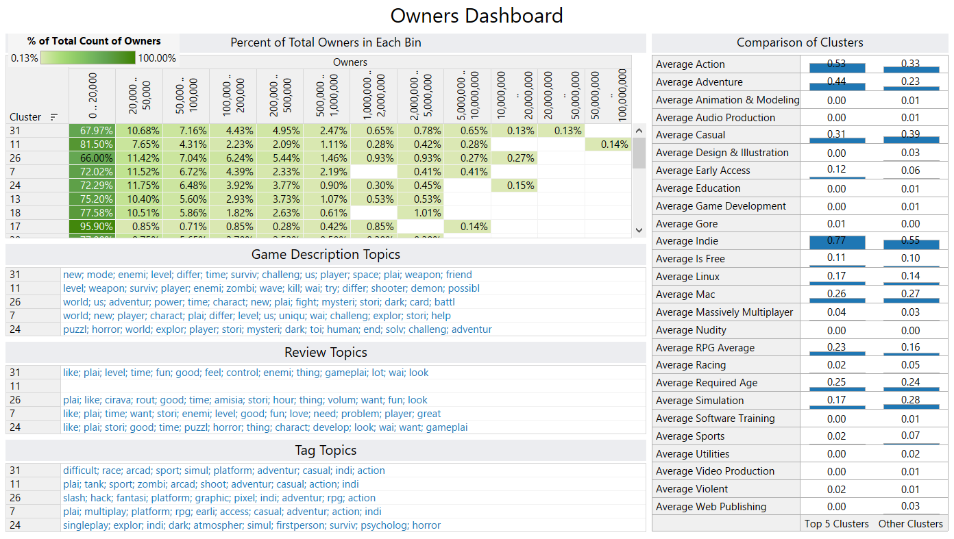
Top 5 Clusters by Ownership

Slide 16
Top 5 Clusters by Ownership
Topics:
Game Descriptions: Adventure survival games with characteristics like mystery horror, zombies, demons,etc. Emphasis on challenging games, story telling, and world building
Reviews: Descriptions like fun, puzzle/problem solving, and story
Tags: Diverse range of tags including difficulty, horror themes (like zombies, slashing, horror, dark, psychological, etc.)
No distinction between multiplayer and single player
Genres and Categories:
Higher rate of action, adventure, indie, RPG and Early access games in the top 5 clusters than in the other clusters.
Lower rate of Casual, Simulations, and Sports games

Slide 17
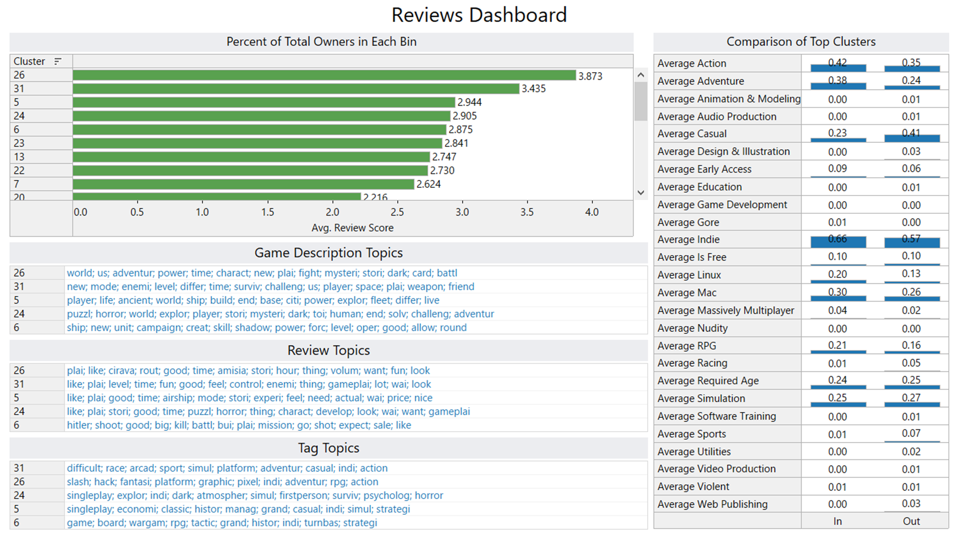
Top 5 Clusters by Review Score

Slide 18
Top 5 Clusters by Review Score
Topics:
Game Descriptions: Dark and mysterious adventure survival games. Emphasis on challenging games, problem solving and world exploration.
Reviews: Descriptions like fun, puzzle/problem solving, and battling/war gameplay
Tags: Diverse range of tags including difficulty, horror themes (like zombies, slashing, horror, dark, psychological, etc.) and historical themes like wargame, strategy, economy, and history.
Genres and Categories:
Higher rate of action, adventure, indie, and RPG games in the top 5 clusters than in the other clusters.
Lower rate of Casual, Racing and Sports games

Slide 19
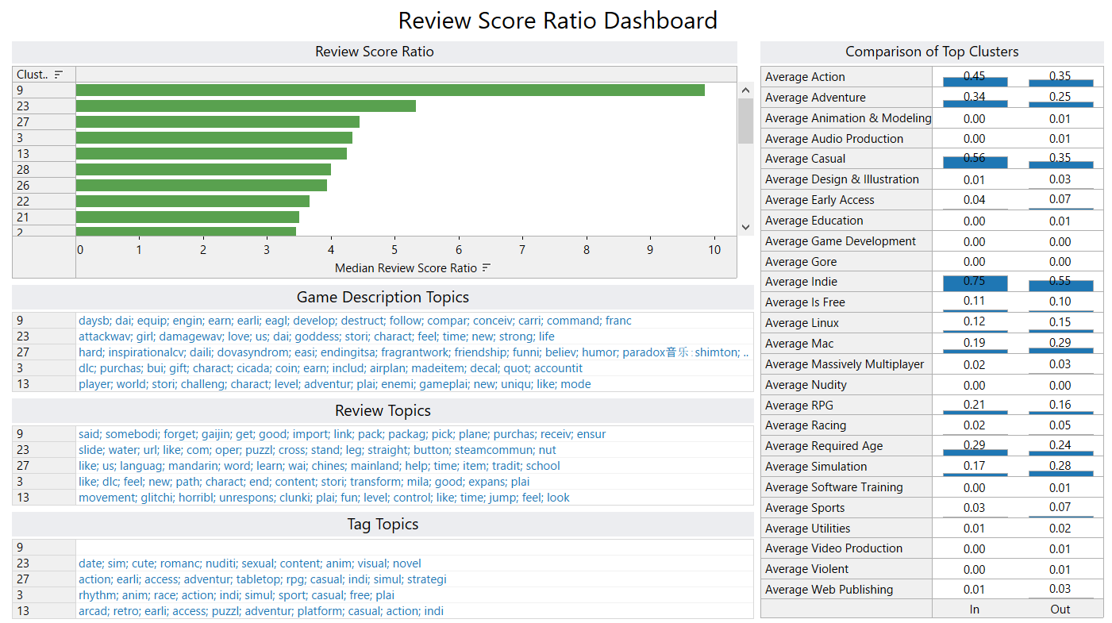
Top 5 Clusters by Review Positivity Ratio (positive review count/negative review count)

Slide 20
Top 5 Clusters by Review Score Ratio
Topics:
Game Descriptions: A little less coherent than the other success metrics. Themes include inspirational, challenging, and funny.
Reviews: Terms like puzzle, learning, and explanation are used. Interestingly one cluster had negative terms like clunky, glitchy and horrible in addition to fun.
Tags: Themes include romance, adventure, action and indie.
Genres and Categories:
Higher rate of action, adventure, casual, indie, and RPG games in the top 5 clusters than in the other clusters.
Lower rate of Simulation Racing, Sports, and Early Access games

Slide 21
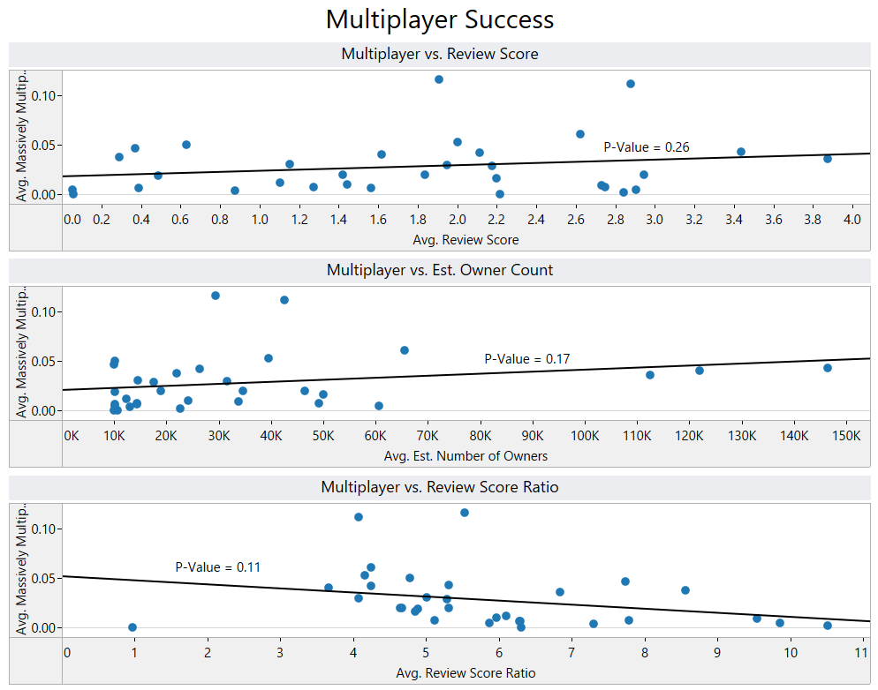
Investigating Multiplayer Games

Slide 22
Characteristics of the Most Successful Games
Most successful games are in the Action/Adventure/Indie genres.
Horror games appear among the most successful games
Features that appear most important to successful games:
Difficulty/Challenge rating
Story and world building
Puzzles and Problem Solving
Being labelled a Massively Multiplayer game was not correlated with higher success

Slide 23
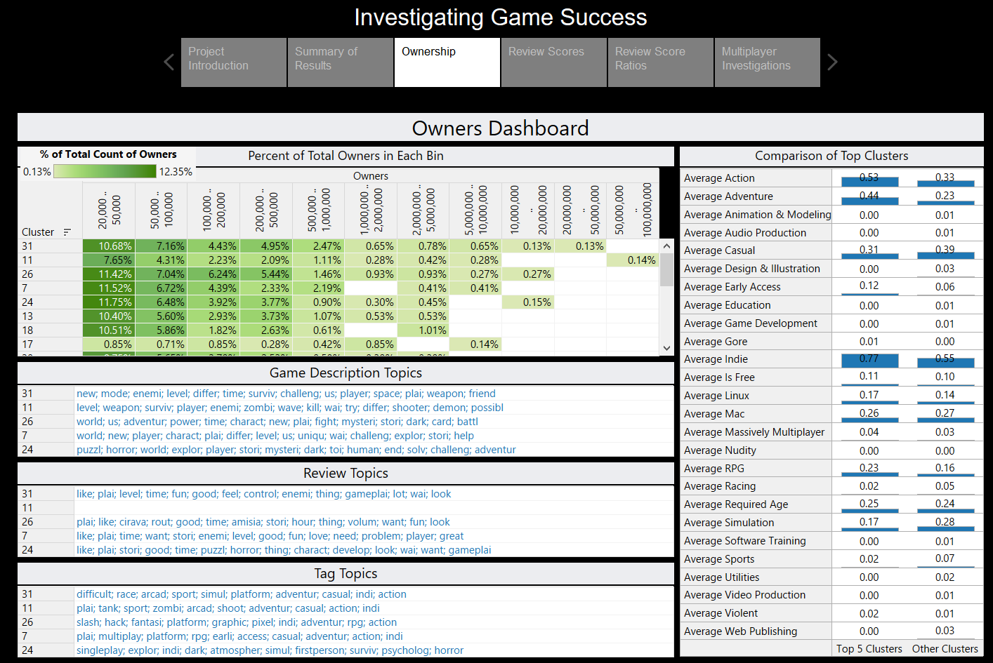
Tableau Dashboard
Game Data Analysis Dashboard

Slide 24
Future Research
Scaling of the analysis to other game aggregator platforms and including additional data
Application of additional machine learning models for classification and game success prediction.
Development of an App for deployment of the learning model.

Slide 25
References
Global Frontier Report—Google for Games. (n.d.). Retrieved February 6, 2022, from https://games.withgoogle.com/reports/
Global Insights Report—Google for Games. (n.d.). Retrieved February 6, 2022, from https://games.withgoogle.com/reports/insightsreport/
Number of games released on Steam 2021. (n.d.). Statista. Retrieved February 6, 2022, from https://www.statista.com/statistics/552623/number-games-released-steam/
Video game market value worldwide 2015. (n.d.). Statista. Retrieved February 6, 2022, from https://www.statista.com/statistics/292056/video-game-market-value-worldwide/
https://towardsdatascience.com/keyword-extraction-process-in-python-with-natural-language-processing-nlp-d769a9069d5c
https://colab.research.google.com/github/explosion/spacy-notebooks/blob/master/notebooks/conference_notebooks/pydays/topic_modelling.ipynb
https://partner.steamgames.com/doc/webapi/ISteamApps
https://steamspy.com/api.php
https://steamdb.info/stats/releases/
https://github.com/ydataai/pandas-profiling
Blei, D. M., Ng, A. Y., & Jordan, M. I. (2003). Latent Dirichlet Allocation. Journal of Machine Learning Research, 3(Jan), 993–1022.
Carbonetto, P., Sarkar, A., Wang, Z., & Stephens, M. (2021). Non-negative matrix factorization algorithms greatly improve topic model fits. https://arxiv.org/abs/2105.13440v2
Lee, D. D., & Seung, H. S. (1999). Learning the parts of objects by non-negative matrix factorization. Nature, 401(6755), 788–791. https://doi.org/10.1038/4456
Mahata, D., Shah, R. R., Kuriakose, J., Zimmermann, R., & Talburt, J. R. (2018). Theme-Weighted Ranking of Keywords from Text Documents Using Phrase Embeddings. 2018 IEEE Conference on Multimedia Information Processing and Retrieval (MIPR), 184–189. https://doi.org/10.1109/MIPR.2018.00041
Miah, M. S. U., Sulaiman, J., Sarwar, T. B., Zamli, K. Z., & Jose, R. (2021). Study of Keyword Extraction Techniques for Electric Double-Layer Capacitor Domain Using Text Similarity Indexes: An Experimental Analysis. Complexity, 2021, e8192320. https://doi.org/10.1155/2021/8192320
Röder, M., Both, A., & Hinneburg, A. (2015). Exploring the Space of Topic Coherence Measures. Proceedings of the Eighth ACM International Conference on Web Search and Data Mining, 399–408. https://doi.org/10.1145/2684822.2685324
Zvornicanin, E. (2021). When Coherence Score is Good or Bad in Topic Modeling? | Baeldung on Computer Science. https://www.baeldung.com/cs/topic-modeling-coherence-score

